Slide 1

Software QUALITY ENGINERING
Software quality factors and attributes, software quality models

Slide 2
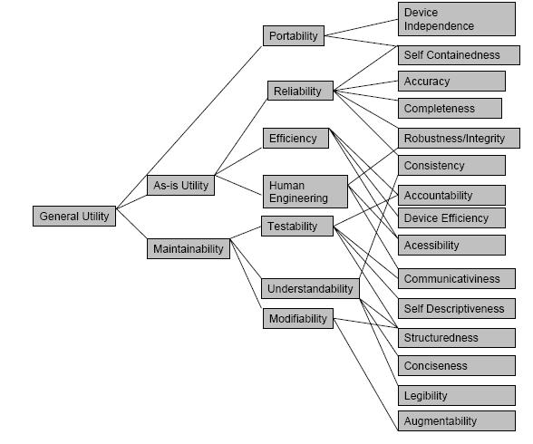
Boehm’s Quality model (1978)
Similar to the McCall Quality Model presents a hierarchical quality model structured around • High-level characteristics • Intermediate level characteristics • Primitive characteristics Software Quality Assurance (SQA)

Slide 3
high-level characteristics
The high-level characteristics represent basic high-level requirements of actual use to which evaluation of software quality could be put – the general utility of software. The high-level characteristics address three main questions that a buyer of software has:
As-is utility : How well (easily, reliably, efficiently) can I use it as-is?
Maintainability: How easy is it to understand, modify and retest?
Portability : Can I still use it if I change my environment?

Slide 4
intermediate level characteristic
The intermediate level characteristic represents Boehm’s 7 quality factors that together represent the qualities expected from a software system: • Portability (General utility characteristics): Code possesses the characteristic portability to the extent that it can be operated easily and well on computer configurations other than its current one. • Reliability (As-is utility characteristics): Code possesses the characteristic reliability to the extent that it can be expected to perform its intended functions satisfactorily. • Efficiency (As-is utility characteristics): Code possesses the characteristic efficiency to the extent that it fulfills its purpose without waste of resources. • Usability (As-is utility characteristics, Human Engineering): Code possesses the characteristic usability to the extent that it is reliable, efficient and human-engineered. • Testability (Maintainability characteristics): Code possesses the characteristic testability to the extent that it facilitates the establishment of verification criteria and supports evaluation of its performance. • Understandability (Maintainability characteristics): Code possesses the characteristic understandability to the extent that its purpose is clear to the inspector. • Flexibility (Maintainability characteristics, Modifiability): Code possesses the characteristic modifiability to the extent that it facilitates the incorporation of changes, once the nature of the desired change has been determined.

Slide 5
lowest level structure
The lowest level structure of the characteristics hierarchy in Boehm’s model is the primitive characteristics metrics hierarchy. The primitive characteristics provide the foundation for defining qualities metrics – which was one of the goals when Boehm constructed his quality model. Consequently, the model presents one more metrics supposedly measuring a given primitive characteristic. Though Boehm’s and McCall’s models might appear very similar, the difference is that McCall’s model primarily focuses on the precise measurement of the high-level characteristics “As-is utility”, whereas Boehm’s quality model is based on a wider range of characteristics with an extended and detailed focus on primarily maintainability.

Slide 6
FURPS/FURPS+
Similar to the McCall’s and Boehm’s Quality Models, it divides quality attributes into two: i. Functional ii. Nonfunctional Software Quality Assurance (SQA)

Slide 7
Cont.
• Functionality – which may include feature sets, capabilities and security • Usability – which may include human factors, aesthetics, consistency in the user interface, online and context sensitive help, wizards and agents, user documentation, and training materials • Reliability - which may include frequency and severity of failure, recoverability, predictability, accuracy, and mean time between failure (MTBF) • Performance - imposes conditions on functional requirements such as speed, efficiency, availability, accuracy, throughput, response time, recovery time, and resource usage • Supportability - which may include testability, extensibility, adaptability, maintainability, compatibility, configurability, serviceability, installability, localizability (internationalization) Software Quality Assurance (SQA)

Slide 8
Dromey’s Quality model(1995)
Dromey has built a quality evaluation framework that analyzes the quality of software components through the measurement of tangible quality properties. Each artifact produced in the software life-cycle can be associated with a quality evaluation model. Dromey gives the following examples of what he means by software components for each of the different models: • Variables, functions, statements, etc. can be considered components of the Implementation model; • A requirement can be considered a component of the requirements model; • A module can be considered a component of the design model.

Slide 9

Dromey’s Quality model

Slide 10
four categories
According to Dromey, all these components possess intrinsic properties that can be classified into four categories: • Correctness : Evaluates if some basic principles are violated. • Internal : Measure how well a component has been deployed according to its intended use. • Contextual : Deals with the external influences by and on the use of a component. • Descriptive : Measure the descriptiveness of a component (for example, does it have a meaningful name.)

Slide 11
Process Quality Standards
Software Process Assessments and Standards
There are two kinds of quality standards:
Maturity Models
Maturity models attempt to measure how well developed (mature) the software process in a particular organization is, and thus how likely it is to produce quality results
Certification Standards
Certification standards measure an organization’s software process against defined standard, and certify the organization if its process meets the standard

Slide 12
ISO 9000 Family of Standards
ISO 9000 Family of Standards
Originally developed in 1987, and revised in 1994, 2000 and again in 2005.
A set of standards and guidelines for quality assurance management
Many customers, especially in Europe, require ISO 9000 registration of their suppliers
Companies become ISO 9000 “registered” as a result of a formal audit by ISO

Slide 13
ISO 9000 Family of Standards
ISO 9000 standards are documentation-based:
every aspect of every step of every process must be backed up by formal documents in a precisely defined format keeping records of how processes are applied
Standards are complex, detailed and stringent
Example: The documentation standard goes so far as to specify:
owner of document must be specified on title page
distribution of document must be controlled with an archived master copy, distribution record book, etc.
version level must be clearly identified
all pages must be consecutively numbered
total number of pages must be indicated on title page
procedure for destruction of obsolete documents must be documented

Slide 14
ISO 9000 Family of Standards
Most companies (60-70%) fail the ISO audit the first time
Most software companies are deficient in corrective actions and document control
Companies take steps to meet the standards in these areas and usually can be registered on the second try

Slide 15
ISO 9000 Family of Standards
There are a number of different standards in the ISO 9000 Family including:
ISO 9000: 2005 covers the fundamentals and defines a vocabulary for quality management systems.
ISO 9001: 2008 defines requirements for quality management systems.
ISO 9004:2009 provides performance improvement guidelines for quality management systems.
... For Details Visit http://www.iso.org

Slide 16
ISO 9000 & Software Quality?
ISO provides documents outlining the application of ISO 9001 (requirements standard) to software
Recall, that ISO standards (including ISO 9001) are not static (originally developed 1987, revised 1994, 2000…)
Standards evolve and improve over time
Documents applying ISO 9001 have also evolved over time: ISO 9000-3:1994 & ISO 9000-3:1997
Application of ISO 9001: 1987 and ISO 9001: 1994 to software
ISO 9000-3 gives the standards for software development, supply and maintenance
ISO 9000-3:1997 specifies 20 elements to be assessed, with detailed requirements for each element

Slide 17
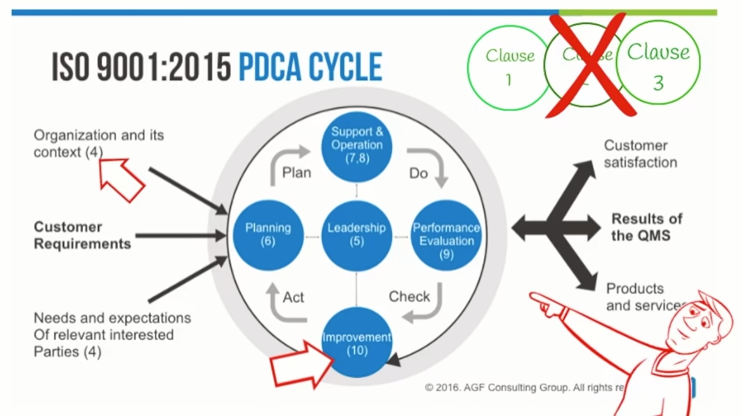

Slide 18
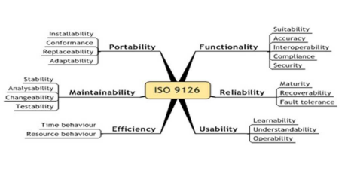
ISO/ IEC 9126 Model

Slide 19
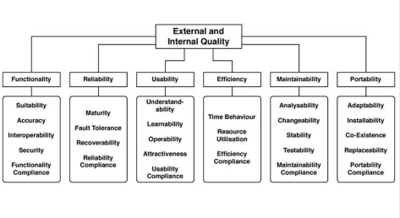
ISO/ IEC 9126 Model

Slide 20
Capability Maturity Model (CMM)
The SEI Process Capability Maturity Model (“CMM”)
CMM defines a five-level scale of process maturity, and an organization’s software process is assessed as “CMM-1”, “CMM-3”, “CMM-5” indicating its level on the scale
Used by government agencies and companies in the U.S.
Assessed using an 85-item questionnaire
ftp://ftp.sei.cmu.edu/pub/education/93em008.pdf

Slide 21
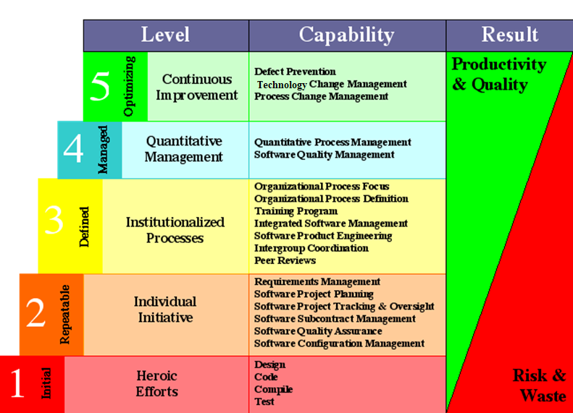
Capability Maturity Model (CMM)
Notes:
3. Institutionalized Processes: Organizational Process Definition. This process involves determining what work is needed to accomplish the goal, assigning those tasks to individuals, and arranging those individuals in a decision‐making framework (organizational structure). The purpose of Organizational Process Focus (OPF) (CMMI-DEV) is to plan, implement, and deploy organizational process improvements based on a thorough understanding of current strengths and weaknesses of the organization's processes and process assets. The training program is defined as an activity or activities that include undertaking one or a series of courses to boost performance, productivity, skills, and knowledge. It is generally a cost-budget endeavor with flexible time. Windchill Integrations for Embedded Software provides a centralized product life management platform that allows companies to develop and manage both hardware and software product components using integrated product configuration, life cycle management, and change management processes.
Windchill Integrations for Embedded Software provides seamless access to software artifacts, such as software executables, source code, and software defects, that are typically contained in remote systems specialized for software development. Product Engineering is the process of innovating, designing, developing, testing and deploying a software product. Intergroup Coordination involves the software engineering group's participation with other project engineering groups to address system-level requirements, objectives, and issues. Representatives of the project's engineering groups participate in establishing the system-level requirements, objectives, and plans by working with the customer and end users, as appropriate. These requirements, objectives, and plans become the basis for all engineering activities. A peer-reviewed publication is also sometimes referred to as a scholarly publication. The peer-review process subjects an author's scholarly work, research, or ideas to the scrutiny of others who are experts in the same field (peers) and is considered necessary to ensure academic scientific quality.
4. Quantitative Management The purpose of Quantitative Project Management (QPM) (CMMI-DEV) is to quantitatively manage the project to achieve the project's established quality and process performance objectives. Software quality management (SQM) is a management process that aims to develop and manage the quality of software in such a way so as to best ensure that the product meets the quality standards expected by the customer while also meeting any necessary regulatory and developer requirements, if any. 5. Continuous Improvement: Defect Prevention (DP) is a strategy applied to the software development life cycle that identifies root causes of defects and prevents them from recurring. It is the essence of Total Quality Management (TQM). Technology Change Management involves identifying, selecting, and evaluating new technologies, and incorporating effective technologies into the organization. The objective is to improve software quality, increase productivity, and decrease the cycle time for product development. The change request management process in systems engineering is the process of requesting, determining attainability, planning, implementing, and evaluating of changes to a system. Its main goals are to support the processing and traceability of changes to an interconnected set of factors.

Slide 22
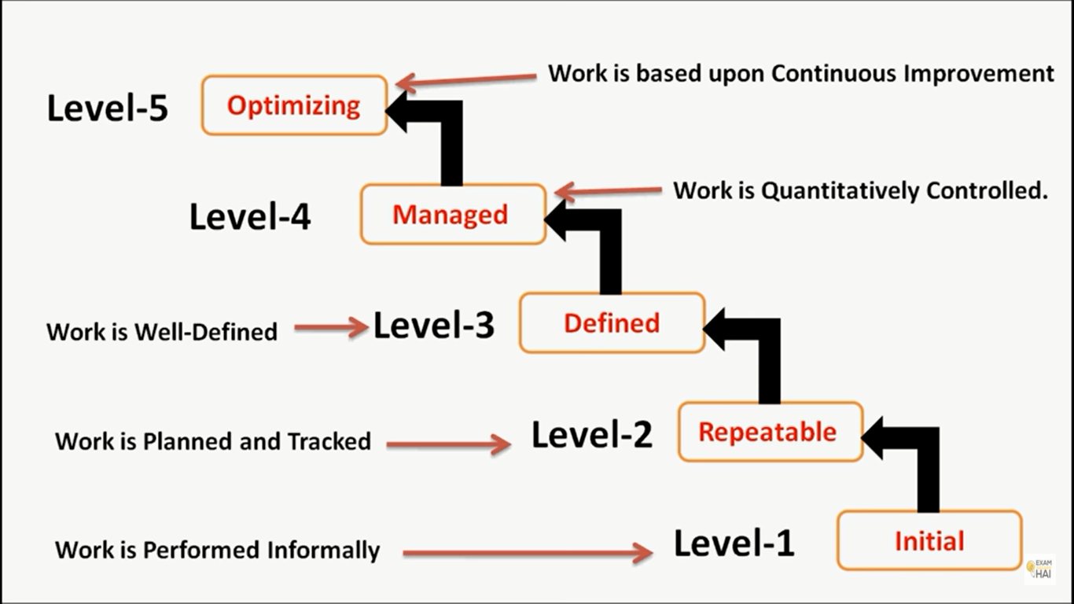

Slide 23
Capability Maturity Model (CMM)
(1) CMM Level 1 - “Initial”
A software development organization at this level is characterized by ad hoc activities. Very few or no processes are defined and followed. Since software production processes are not defined, different engineers follow their own process and as a result development efforts become chaotic. Therefore, it is also called chaotic level. The success is only due to some individuals, and when they leave the organization, the people left behind feel great difficulty to understand what has been done and what is to be done due to lack of processes. This leads to low quality.
(2) CMM Level 2 - “Repeatable”
At this level, the basic project management practices such as tracking cost and schedule are established. cost estimation techniques like function point analysis, COCOMO, etc. are used. The necessary process discipline is in place to repeat earlier success on projects with similar applications. Hence, the existing process is repeated, it is helpful only if we are working on same kind of problems.
(3) CMM Level 3 - “Defined”
At this level the processes for both management and development activities are defined and documented. There is a common organization-wide understanding of activities, roles, and responsibilities. The processes though defined, the process and product qualities are not measured. ISO 9000 aims at achieving this level.

Slide 24
Capability Maturity Model (CMM)
(4) CMM Level 4 - “Managed”
At this level, the focus is on software metrics. Two types of metrics are collected. Product metrics (measures size, reliability, time complexity, understandability)Process metrics (measures average defect correction time, productivity, average number of defects found per hour inspection)Quantitative quality goals are set for the products. The process metrics are used to check if a project performed satisfactorily. Thus, the results of process measurements are used to evaluate project performance rather than improve the process.
(5) CMM Level 5 - “Optimizing”
At this stage, process and product metrics are collected. For example, if from an analysis of the process measurement results, it was found that the code reviews were not very effective and a large number of errors were detected only during the unit testing, then the process may be fine tuned to make the review more effective. Also lessons learned from specific projects are incorporated into the process. Continuous process improvement is achieved both by analyzing the quantitative feedback from the process measurements and from application of innovative ideas and technologies. Such an organization identifies the best software engineering practices and innovations which may be tools, methods, or processes.

Slide 25
Summary
Software processes can be continually improved using meta processes such as the Defect Prevention Process
Software processes can be evaluated with respect to their maturity or by comparison with a process standard
Maturity models include CMM
Process quality standards include ISO 9000

Slide 26
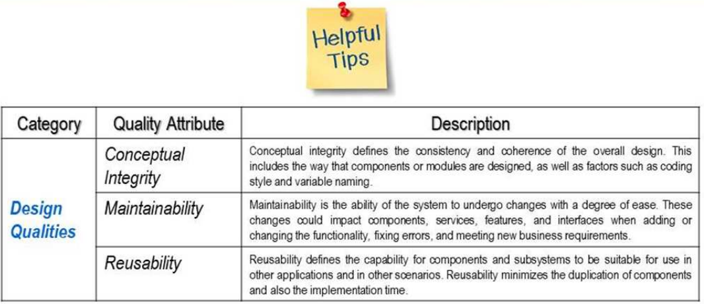
Quality Attribute – Classification

Slide 27
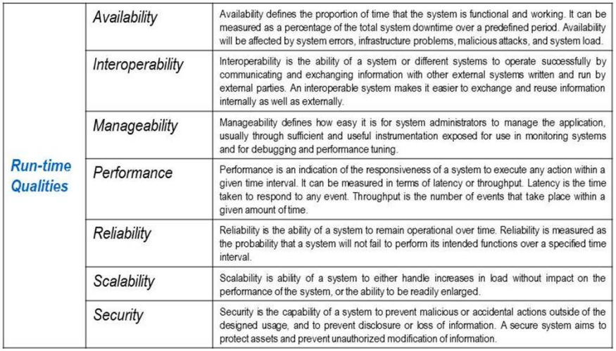
Quality Attribute – Classification

Slide 28
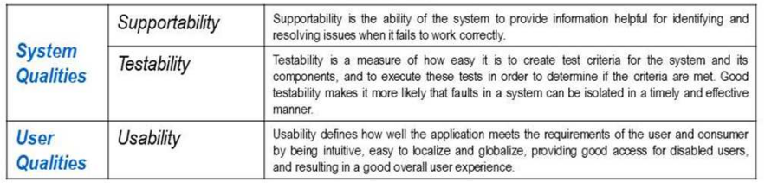
Quality Attribute – Classification

Slide 29
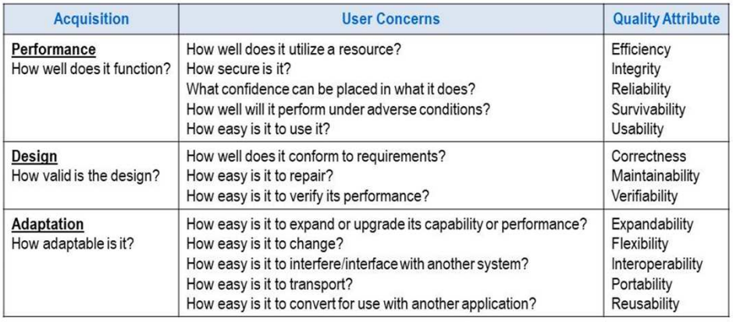
Quality Attribute – Classification

Slide 30

END OF LECTURE
Any Questions !!!

